Slide 1
Workshop Creating Oracle JET Composite Components with OpenLayers GIS library
AMIS SIG/ Oracle Developer Meet Up
Lucas Jellema
Tuesday 23rd January, Nieuwegein, The Netherlands
Notes:
Huidige organisaties maken steeds vaker gebruik van Cloud diensten/oplossingen en data/applicaties van derden, integreren van deze oplossingen met reeds aanwezige applicaties/databronnen (on-premise) is gewenst/vereist. In deze sessie wordt ingegaan op de nieuwste ontwikkelingen en producten die Oracle aanbiedt op het gebied van integratie en hoe organisaties deze uitdaging kunnen oplossen.

Slide 2
Agenda
Introduction of OpenLayers
Demo: Using OpenLayers in JET Applications
Hands-on: OpenLayers in JET Applications
Dinner
Introduction JET CCA Composite Components
Demo: Creating a JET Composite Component based on OpenLayers
Hands-on: Building JET Composite Components
With Rich Geo functionality based on OpenLayers

Slide 3
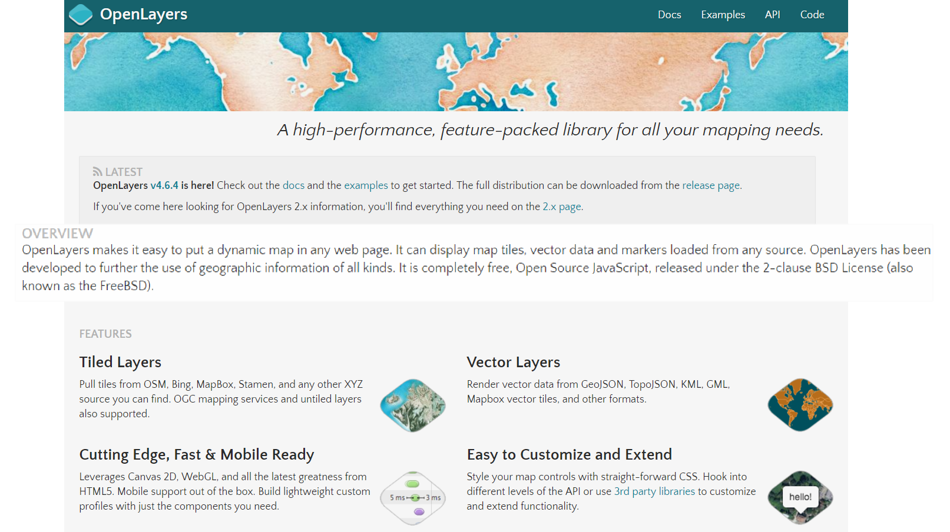
Introducing OpenLayers (open source, HTML5, JavaScript)
Notes:
Examples: http://openlayers.org/en/latest/examples/
API: http://openlayers.org/en/latest/apidoc/
Quickstart: https://openlayers.org/en/latest/doc/quickstart.html
On Line Editor: http://programmerg.github.io/ol3editor/

Slide 4

OpenLayers - Summary
Initial release: 2006
Most recent release: 4.6.4, early 2018
Since 2007 under Open Source GeoSpatial Foundation (OSGeo)
Originally based on Prototype JavaScript Framework; still fully (client side) JavaScript
Support for GeoRSS, KML (Keyhole Markup Language), Geography Markup Language (GML), GeoJSON and map data from any source using OGC-standards as Web Map Service (WMS) or Web Feature Service (WFS).
Map sources include Bing, Open Street Map, MapBox, Stamen, ArcGis (Esri)
Notes:
https://en.wikipedia.org/wiki/OpenLayers
https://en.wikipedia.org/wiki/Open_Source_Geospatial_Foundation
https://en.wikipedia.org/wiki/OpenStreetMap
Sites using OpenLayers: https://www.wappalyzer.com/technologies/openlayers

Slide 5
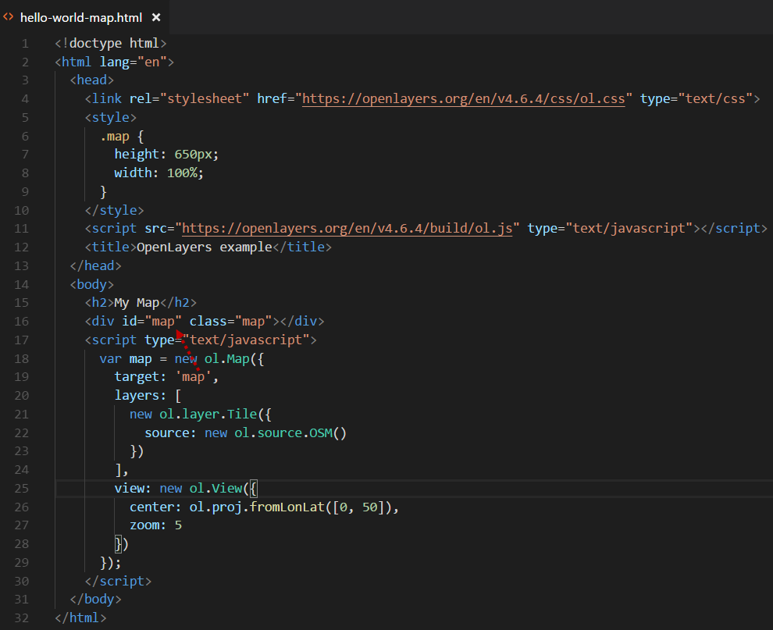
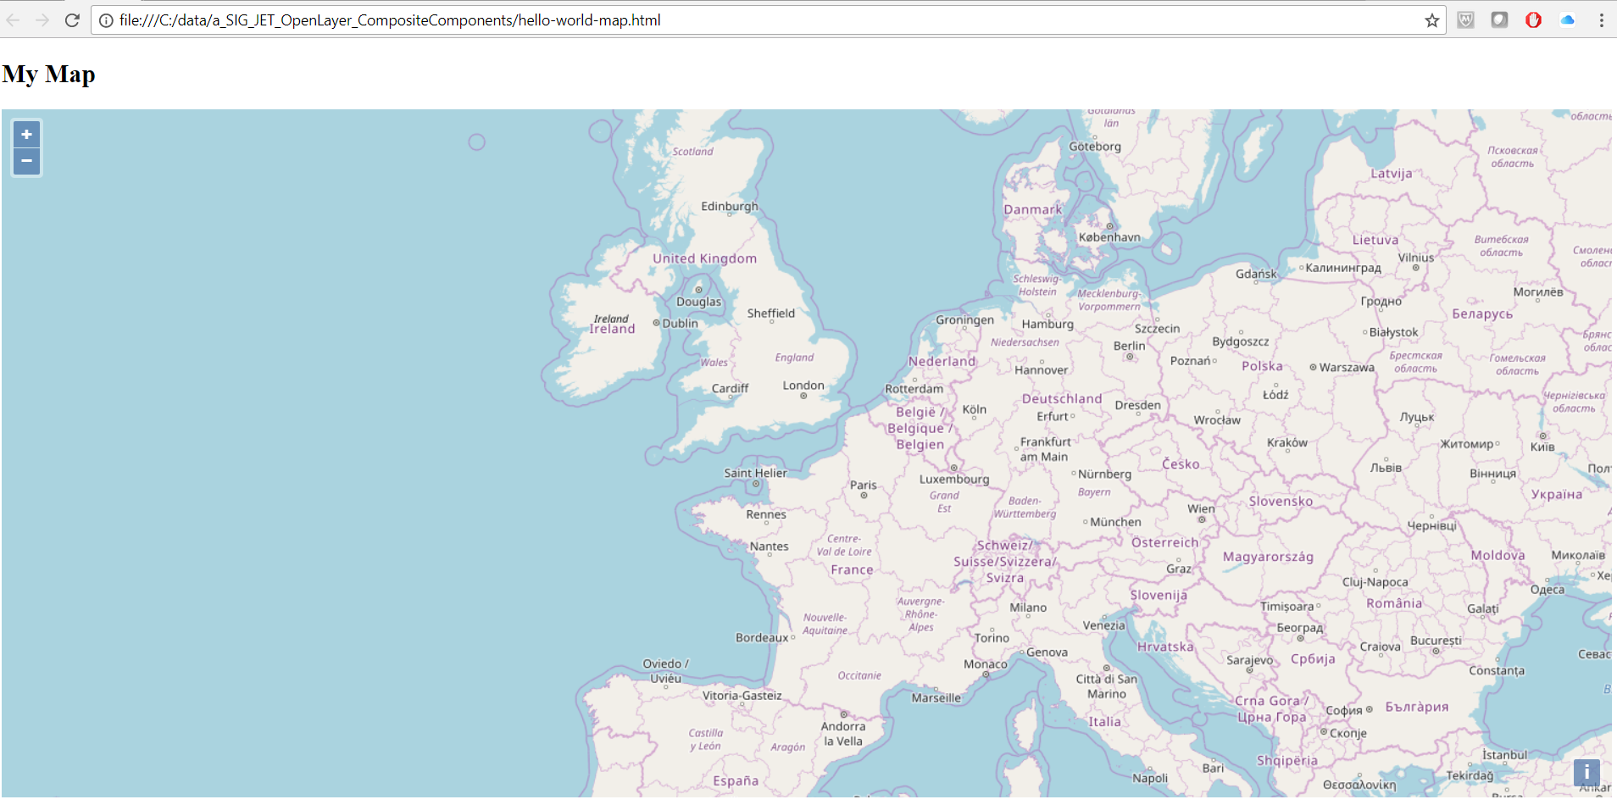
Hello World Map
Notes:
https://openlayers.org/en/latest/doc/quickstart.html

Slide 6
Key Concepts in OpenLayers
Map – associated with container DOM element
Layers – based on [URL to] source external services like OpenStreetMap or Bing or local Vectors
View – to specify projection, center and zoom-level for map
Style – specify the fill, stroke (color, width), text for features to be rendered
Vector – collection of features to render client side on a map [layer]
Interaction – user actions on the map to which functions can be tied

Slide 7
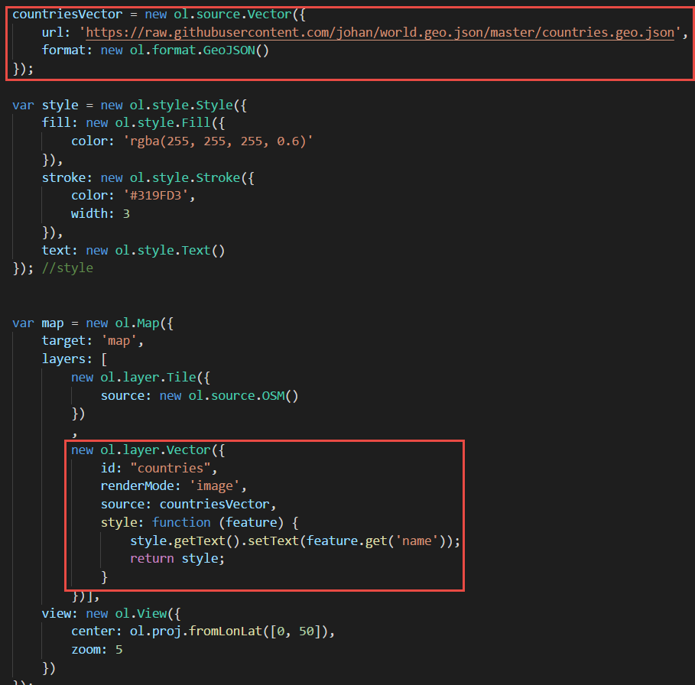
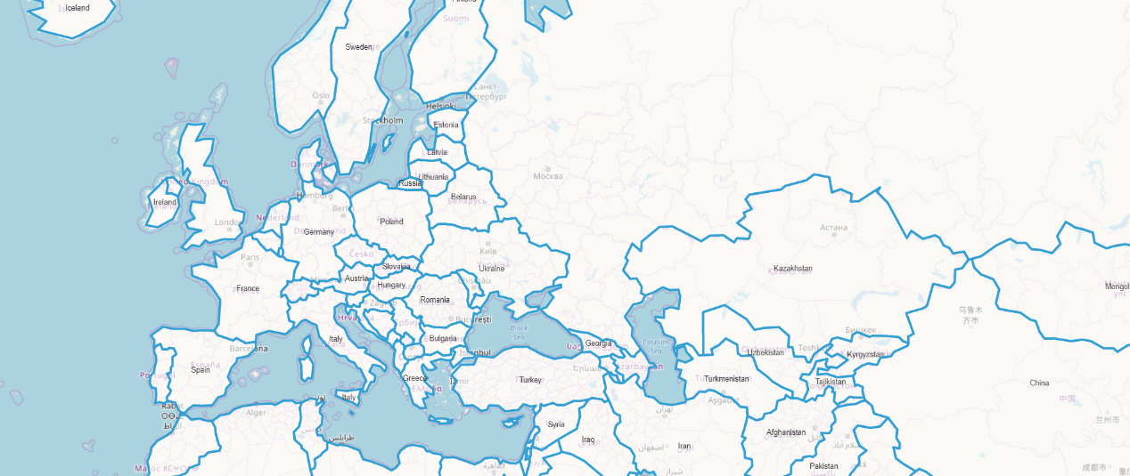
Step One: Show countries

Slide 8
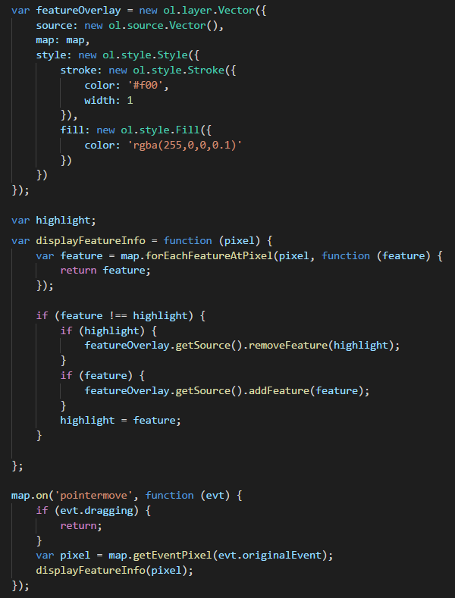
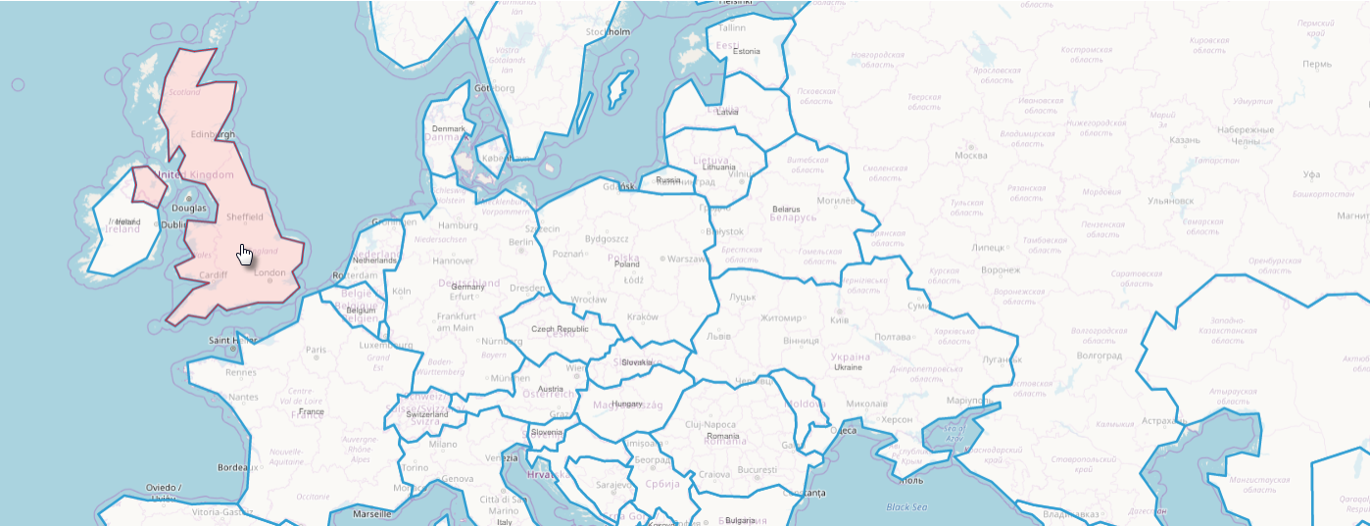
Step Two: highlight country when hovering over it

Slide 9
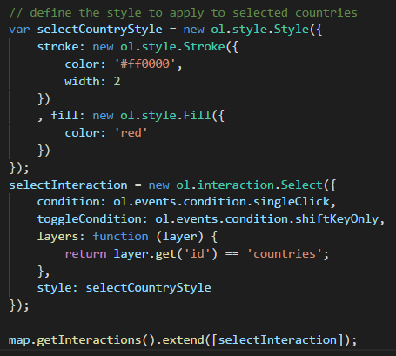
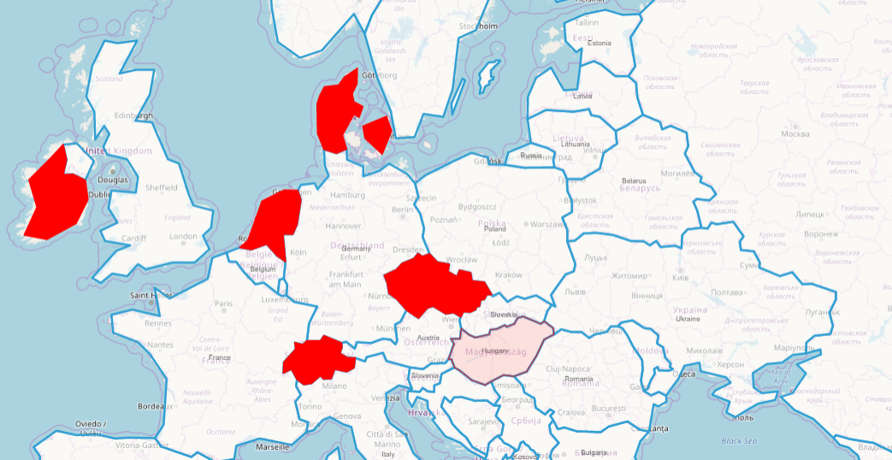
Step 3: Select countries

Slide 10
Integrate OpenLayers in JET Applications
Generic, application wide:
Create directory js/libs/openlayers
Extract resources from OpenLayers zip-distribution to this directory
Add entries for OpenLayers resource (js and css) to js/main-release-paths.json file
Configure OpenLayers in the RequireJS bootstrap file – typically main.js
In JET modules that use OpenLayers
Add container elements (typically DIV) in View (HTML)
Add JavaScript code in ViewModel to configure the OpenLayers map
Define layers and sources, views, styles, interactions and event handlers
Configure data binding between map and observables in ViewModel

Slide 11
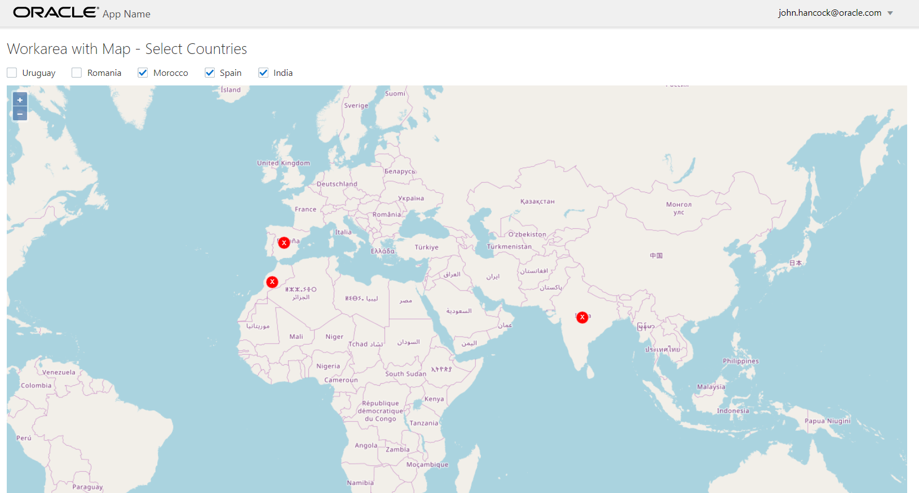
Demo OpenLayers in JET Applications

Slide 12
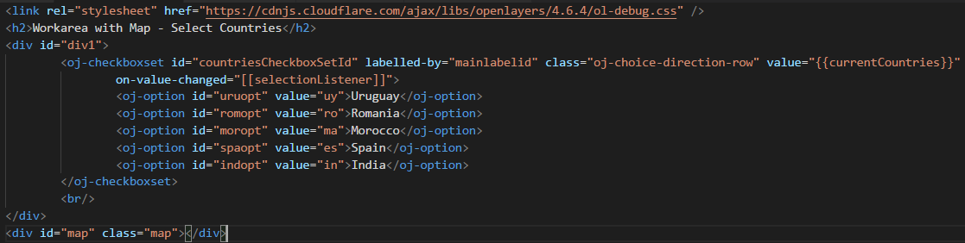
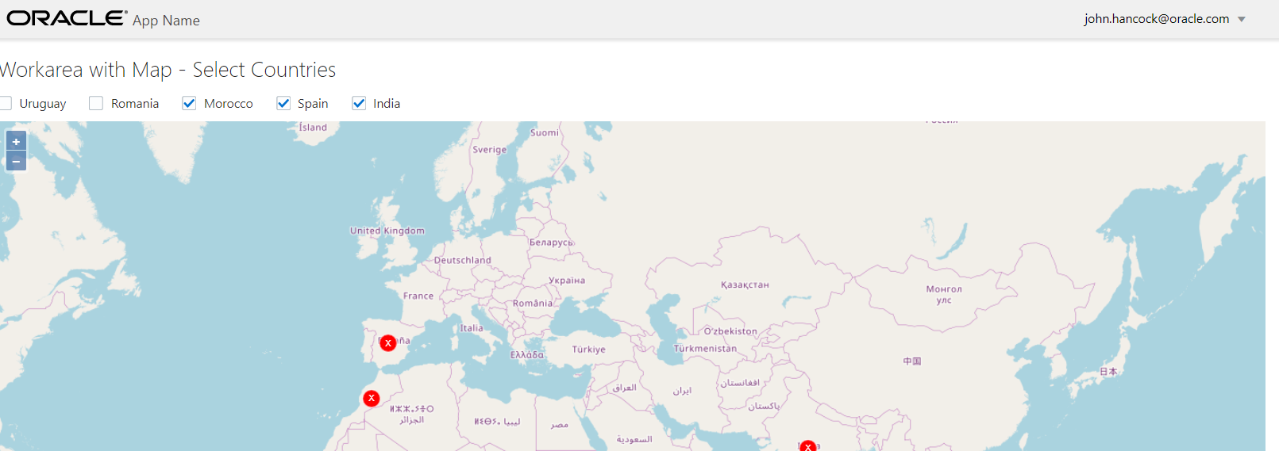
View – with Map container element and regular JET components

Slide 13
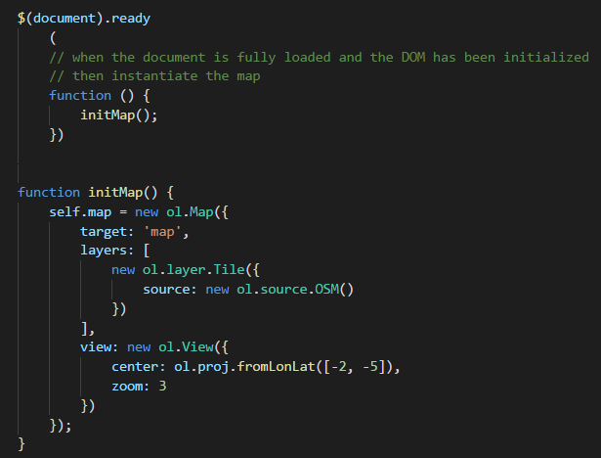
ViewModel – Initialize Map

Slide 14
ViewModel – what more?
Create a HashMap of OpenLayers features per country
Associate CheckboxSet with Change Event Listener
In the Event Listener:
Create a new Vector and Layer based on the current set of selected countries – picking the selected country features from the HashMap
Define the style to use for the country features
And associate this Layer with the map (after removing the current layer for selected countries)

Slide 15
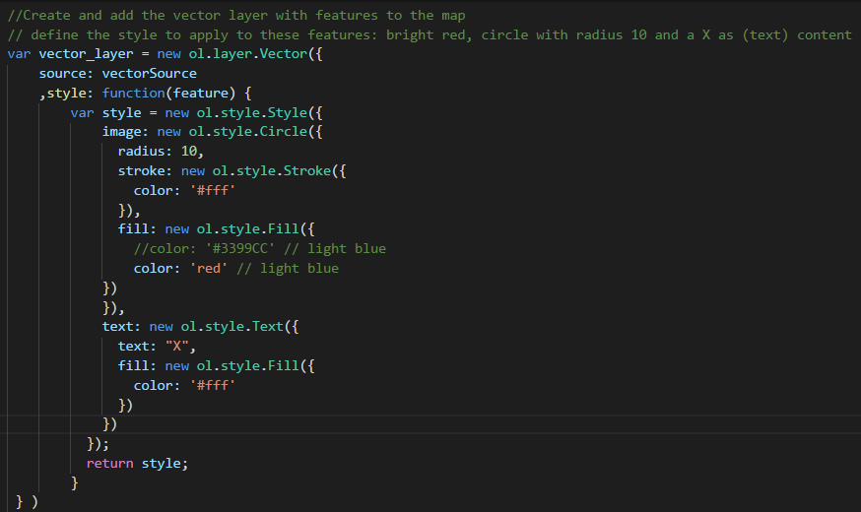
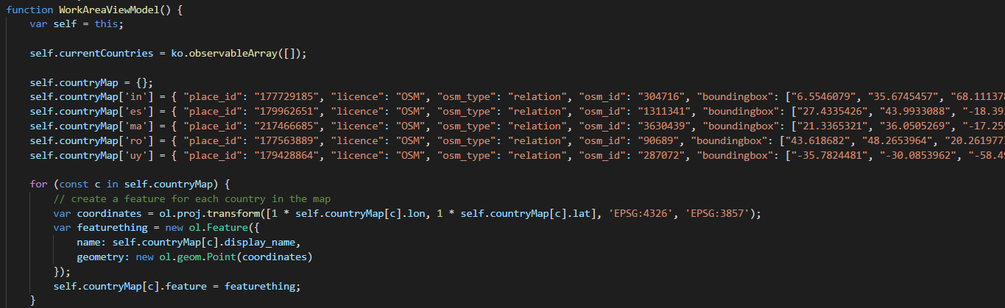
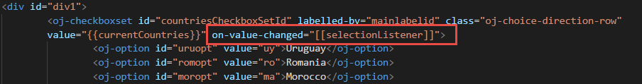
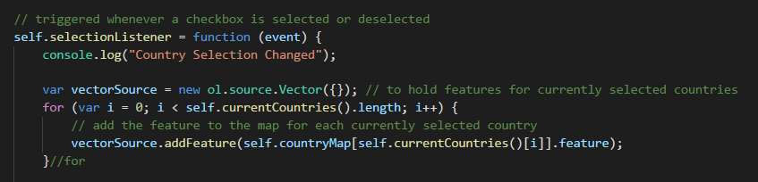
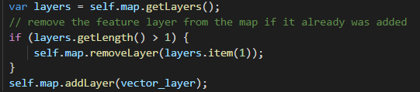
ViewModel – what more?
Create a HashMap of OpenLayers features per country
Associate CheckboxSet with Change Event Listener
In the Event Listener:
Create a new Vector and Layer based on the current set of selected countries – picking the selected country features from the HashMap
Define the style to use for the country features
And associate this Layer with the map (after removing the current layer for selected countries)
Creating Oracle JET Composite Conponents with OpenLayers?
15

Slide 16
Hands On OpenLayers and JET
Create a JET application
Download and add OpenLayers library
Configure JET application for using OpenLayers
Leverage OpenLayers
Add a world map to a JET module
Highlight countries selected in JET on the OpenLayers Map
Select countries by clicking on the map and pass the selection to the JET ViewModel
Embed OpenLayers component in JET Popup [for smooth user experience]
…. (anything you fancy and OpenLayers)

Slide 17
Introducing JET Composite Component Architecture (CCA): “A composite component is a reusable piece of UI that can be embedded as a custom HTML element and can be composed of other composites, JET components, HTML, JavaScript, or CSS.”
Notes:
http://www.oracle.com/webfolder/technetwork/jet/jetCookbook.html?component=composite&demo=basic

Slide 18
JET Composite Component
A reusable building block – encapsulated with a well defined interface
Created using HTML, CSS, JavaScript, JET resources, other CCA components
Packaged in a Zip file that can be shared with any application and any team
Easily ‘injected’ into a JET application
copy contents of zip-file to specific directory
And easily used in a page
Add tag to View
Load module in ViewModel
JET CCA
InputSmiley
My JET Application
Your JET Application
Page 1
Page 2
JET CCA
InputSmiley
JET CCA
InputSmiley
Page A
Page B
<input-smiley>
<input-smiley>
<input-smiley>
<input-smiley>
<input-smiley>
<input-smiley>
<input-smiley>

Slide 19
Constitution of a JET Composite Component
JET CCA
Component
UI (HTML + CSS)
Events, Property Updates, Function calls

Slide 20
Constitution of a JET Composite Component
JET CCA
Component
UI (HTML + CSS)
loader.js
view.html
Events, Property Updates, Function calls
component.json
styles.css
Other Resources
viewModel.js

Slide 21
Constitution of a JET Composite Component
Property values (can be Observables and callback functions), Function Calls
JET CCA
Component
UI (HTML + CSS)
loader.js
view.html
Events, Property Updates, Function calls
component.json
styles.css
Other Resources
viewModel.js

Slide 22
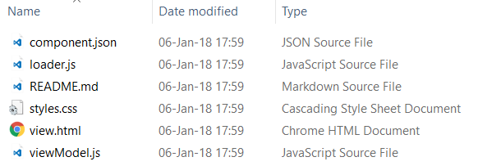
Steps for Creating a Composite Component
Use ojet create component <name of component>
This creates
A directory /js/jet-composites/<name of component>
The skeleton files for the composite component

Slide 23
Next Steps for Creating a Composite Component
Define output (view.html)
Define “logic” (viewModel.html)
Define properties (in component.json)
And wire up view aspects to those properties
And read & manipulate properties in viewModel
And make calls from viewModel to functions passed in as property
Define events (in component.json) that Component may publish
And write the logic to publish those events in viewModel
Define functions (in component.json) that Component exposes
And write the logic for these functions in viewModel
Add additional resources – CSS, Images, JavaScript – and add these to loader.js

Slide 24
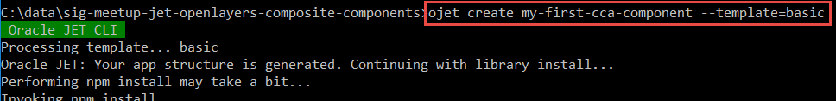
Simple Composite Component
Create new JET project:
Create new JET Composite Component hello-world:

Slide 25
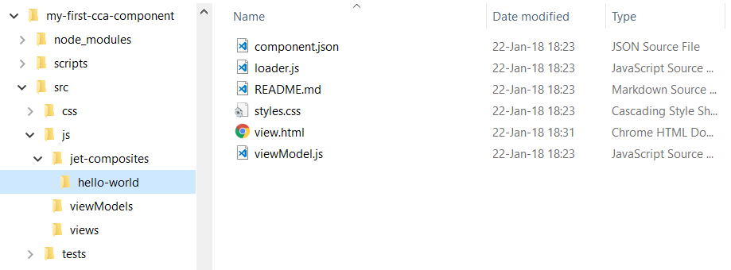
Component Workspace application plus virgin Hello World

Slide 26
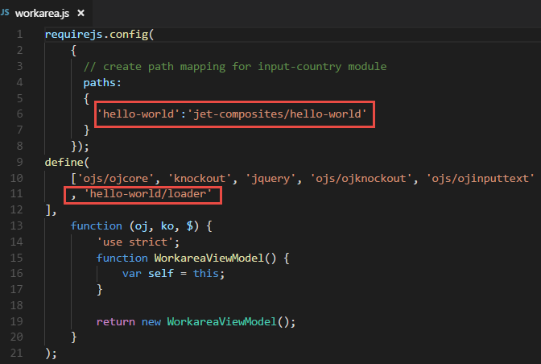
Include Component in Application
Create Module Workarea
workarea.js:
require.config paths
define hello-world/loader

Slide 27
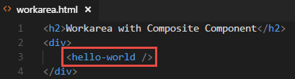
Include Component in Application
Create Module Workarea
workarea.js:
require.config paths
define hello-world/loader
workarea.html
add <hello-world>

Slide 28
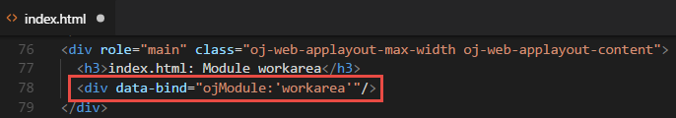
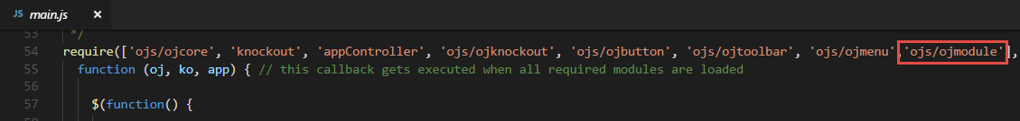
Include Component in Application
Create Module Workarea
workarea.js:
require.config paths
define hello-world/loader
workarea.html
add <hello-world>
Add Module Workarea
add module to index.html
add ojModule to main.js

Slide 29
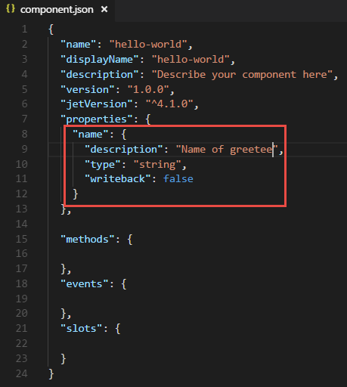
Define and use property
Add property in component.json

Slide 30
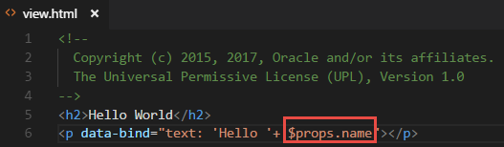
Define and use property (2)
Add property in component.json
Make use of property in view.html

Slide 31
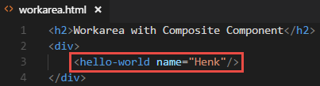
Define and use property (3)
Add property in component.json
Make use of property in view.html
Provide value of property in consuming application

Slide 32
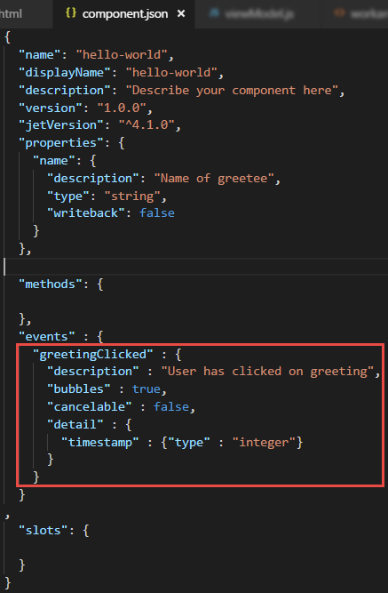
Publish Event from Component
Add event in component.json

Slide 33
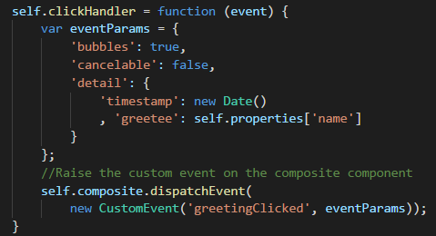
Publish Event from Component (2)
Add event in component.json
Publish event from viewModel.js

Slide 34
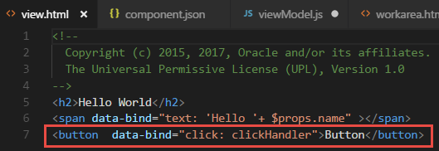
Publish Event from Component (3)
Add event in component.json
Publish event from viewModel.js
“Cause” event in view.html

Slide 35
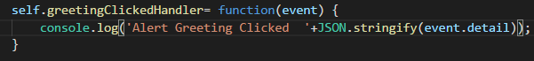
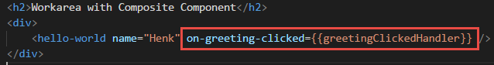
Consume Event in application
Define listener function in ViewModel
Configure event listener in View

Slide 36
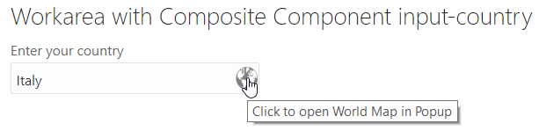
Hands On on JET Composite Components
Create simple CCA component
Consume (try out) CCA component in JET application

Slide 37
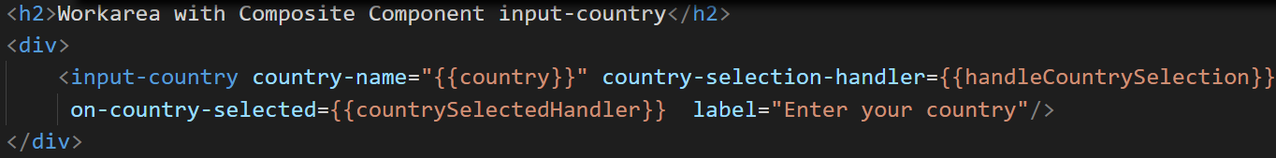
Hands On on JET Composite Components
Create simple CCA component
Consume (try out) CCA component in JET application
Enrich CCA component
Properties (two-way bound, call-back functions)
Embedded resources (images, CSS stylesheets, JavaScript libraries)
Events & Listeners
Expose functions to be invoked by component consumers
Embed OpenLayers in CCA Component
Add two-way country selection and event publication

Slide 38
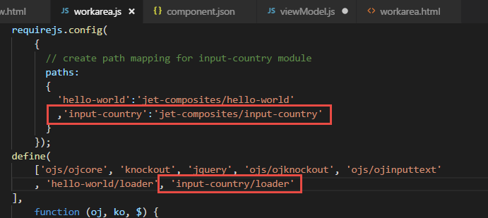
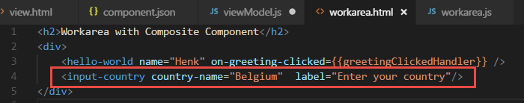
Demo consumption of “rich composite component”
Unzip to consuming application
Add to ViewModel
Add to View

Slide 39
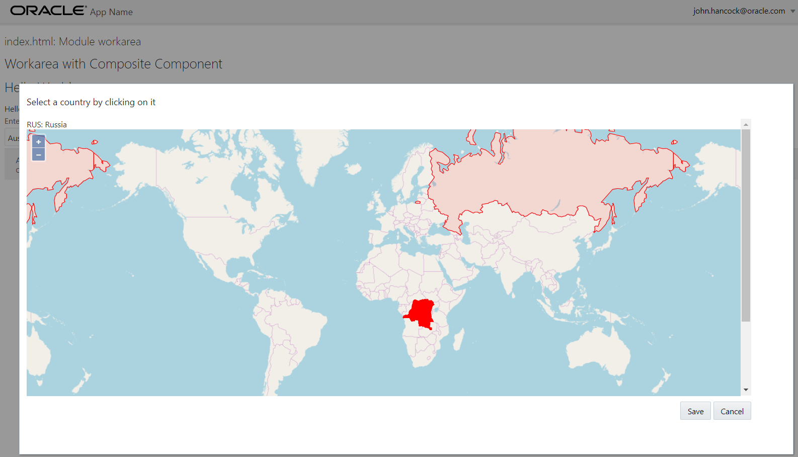

Slide 40




Thank you!
Blog: technology.amis.nl
Email: lucas.jellema@amis.nl
: @lucasjellema
: lucas-jellema
: www.amis.nl, info@amis.nl

